Slide 1
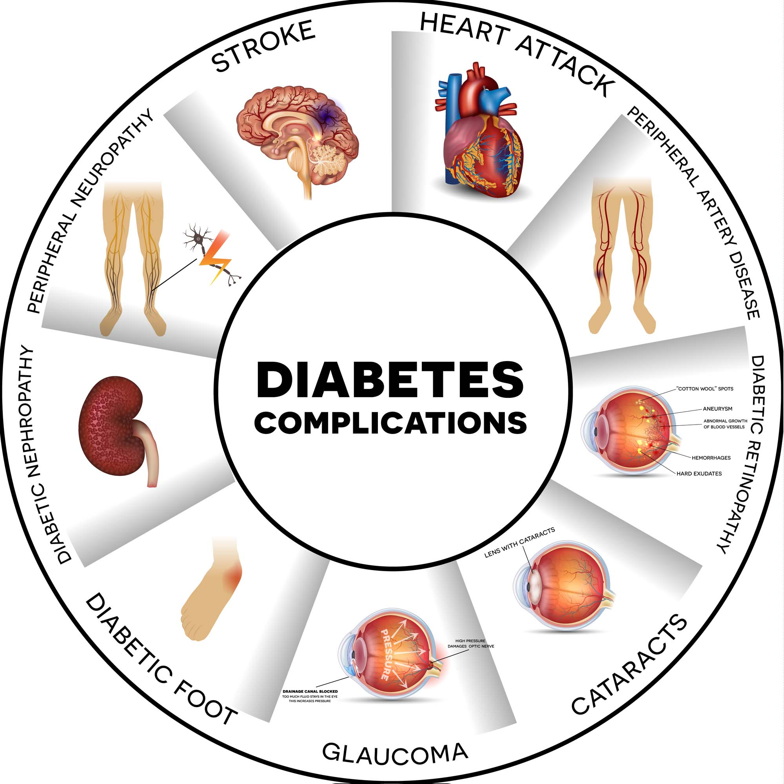
Factors Affecting Diabetes
Data Analysis
~ Divya Thakur

Slide 2
Description
Context
This dataset is originally from the National Institute of Diabetes and Digestive and Kidney Diseases. The objective of the dataset is to diagnostically predict whether or not a patient has diabetes, based on certain diagnostic measurements included in the dataset. Several constraints were placed on the selection of these instances from a larger database. In particular, all patients here are females at least 21 years old of Pima Indian heritage.
Content
The dataset consists of several medical predictor variables and one target variable, Outcome. Predictor variables include the number of pregnancies the patient has has, their BMI, insulin level, age and so on.
Acknowledgements
Smith, J.W., Everhart, J.E., Dickson, W.C., Knowler, W.C., & Johannes, R.S. (1988). Using the ADAP learning algorithm to forecast the onset of diabetes mellitus. In Proceedings of the Symposium on Computer Applications and Medical Care (pp. 261--265). IEEE Computer Society Press.

Slide 3
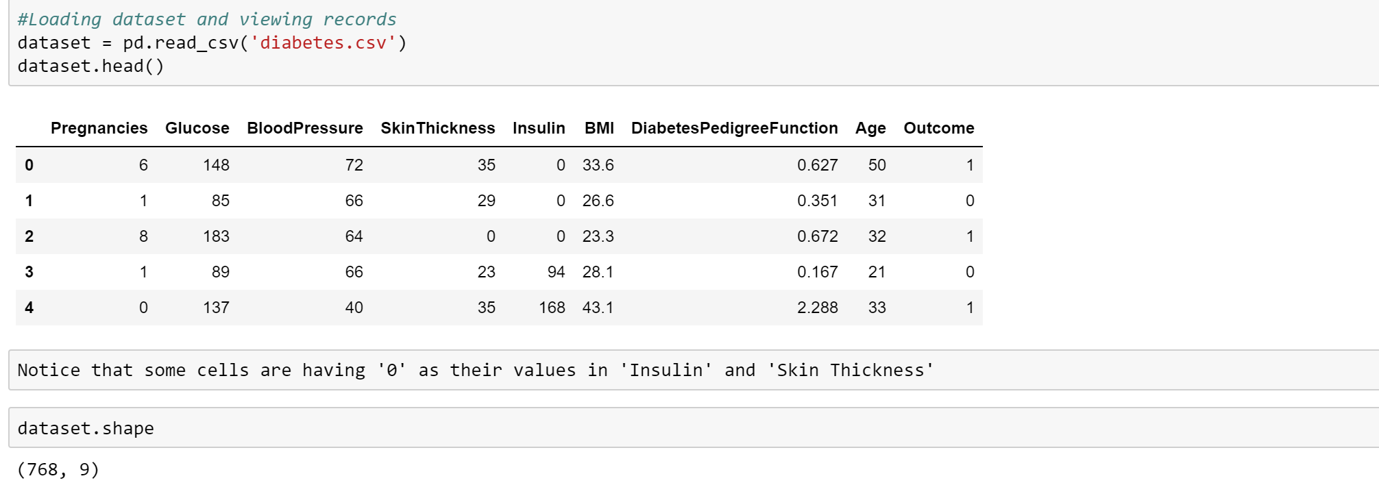
Loading the Data & Viewing It
768 Rows and 9 Columns

Slide 4
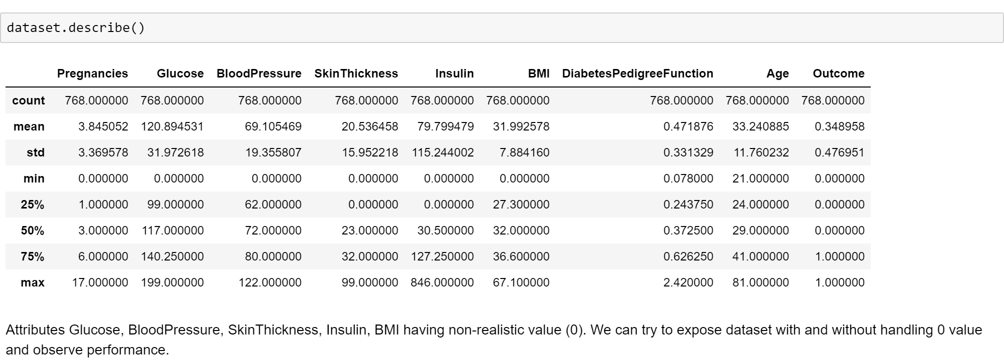
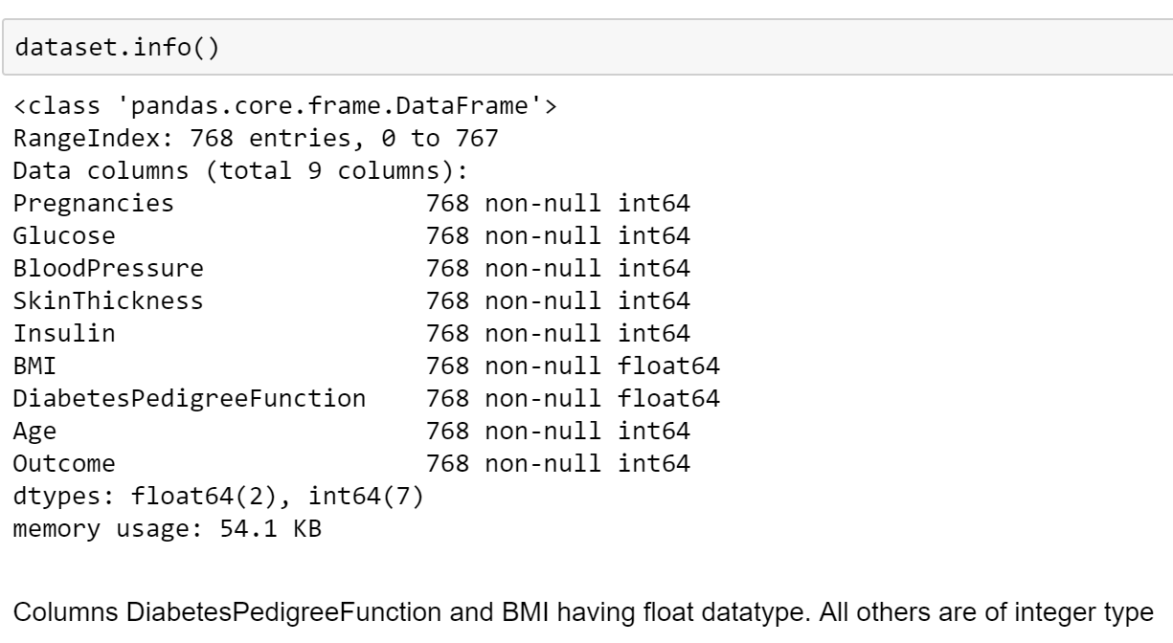
Gathering Dataset’s Info

Slide 5
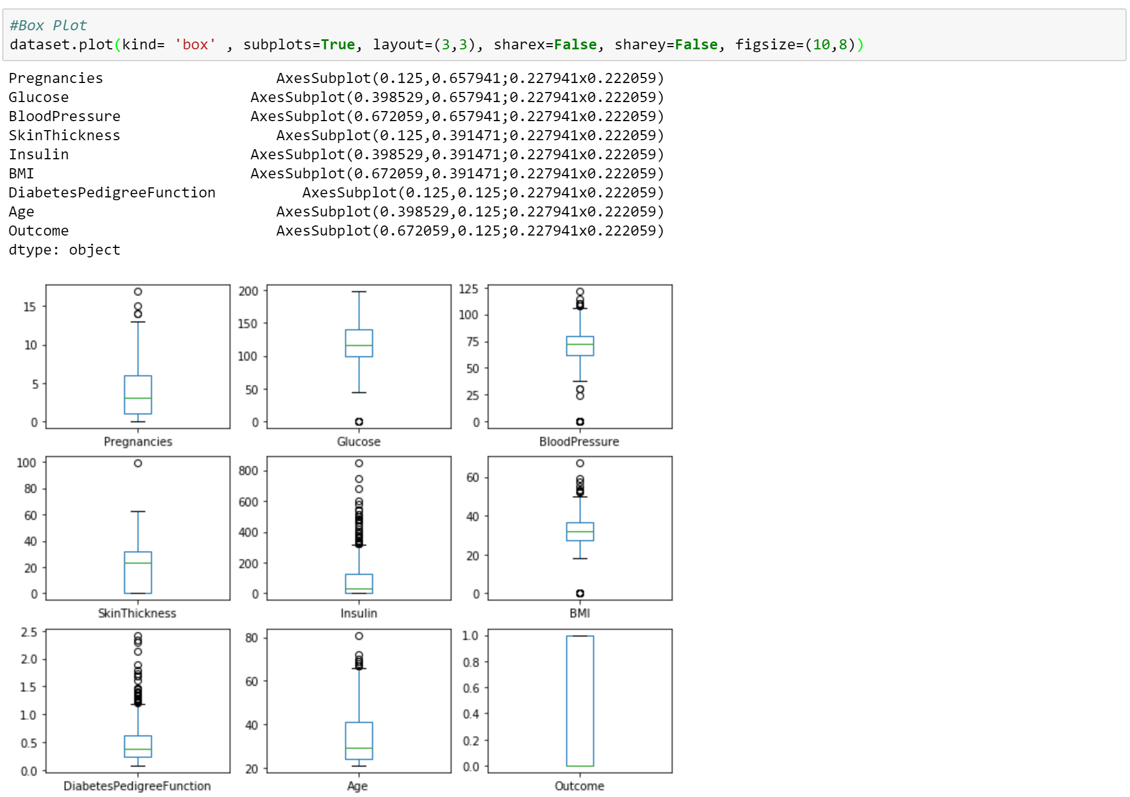
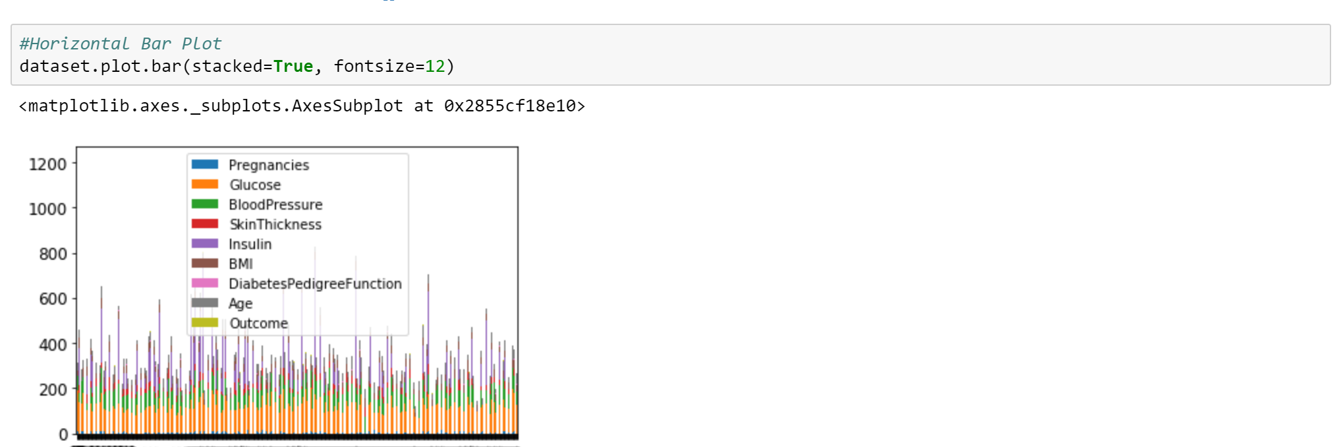
DATA VISUALIZATION
BOX PLOT
BAR PLOT

Slide 6
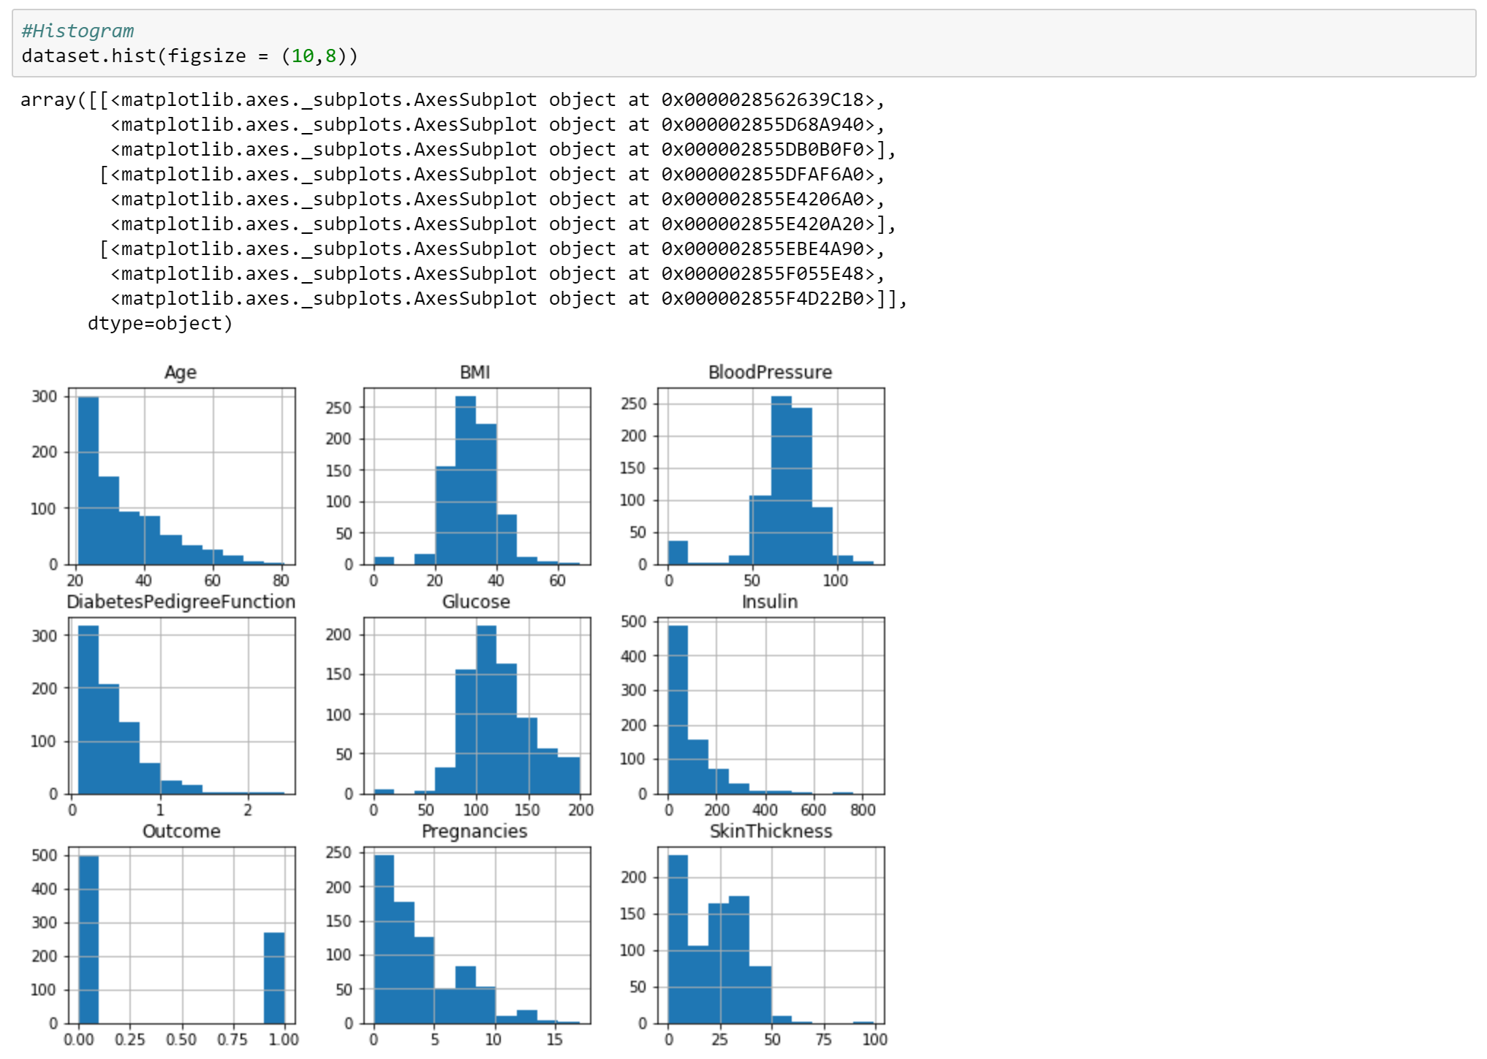
Data Visualisation With Histogram

Slide 7
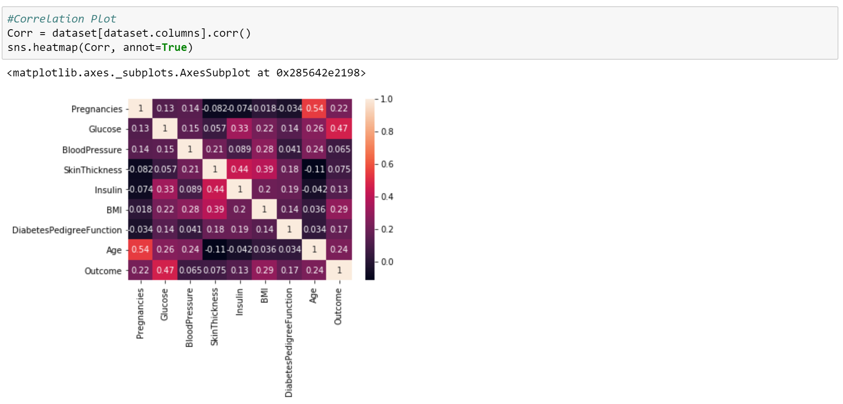
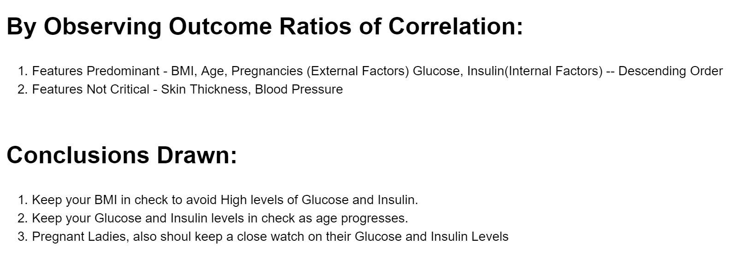
Correlation, Insights & Conclusions

